Slide 1
Lab Meeting 7/22/25
By Evan Johns

Slide 2
Specific Aims
Research AIM 1: Quantify the Proximity Between Neutrophils and Different T cell Subsets in HNSCC Responder and Non-Responder Tissues.
Research AIM 2: Label Neutrophils in the mRNA CosMX samples and identify Ligand-Receptor Pairs Associated with Neutrophil and T cell Interactions

Slide 3
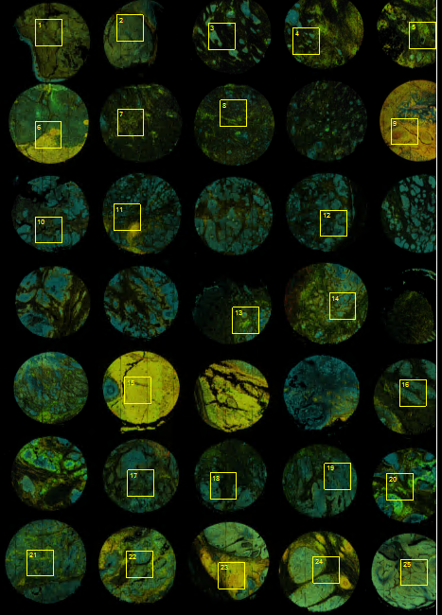
Project Data Summary - Protein
CosMx Protein Assay
68 samples from 26 patients of HNSCC
64 panel protein expression
Morphology visualization: PanCK, CD45, CD3, CD298/B2M antibodies and DAPI
64-Plex CosMx Protein IO Panel
4-1BB | CD14 | CD31 | CD56
B7-H3 | CD15 | CD34 | CD68
Bcl-2 | CD16 | CD38 | CD8
Beta-catenin | CD163 | CD39 | CTLA4
CCR7 | CD19 | CD4 | EGFR
CD11b | CD20 | CD40 | EpCAM
CD11c | CD27 | CD45 | FABP4
CD127 | CD3 | CD45RA | Fibronectin
FOXP3 | IDO1 | LAMP1 | Rabbit IgG
GITR | IgD | Mouse IgG1 | SMA
GZMA | IL-18 | NF-kB p65 | STING/TMEM173
GZMB | IL-1b | p53 | Syndecan-1
HER2 | IL3RA/CD123 | pan-RAS | TCF1/TCF7
HLA-DR | iNOS | PD-1 | TIM3
ICAM1 | Ki-67 | PD-L1 | Vimentin
ICOS | LAG3 | PD-L2 | VISTA

Slide 4
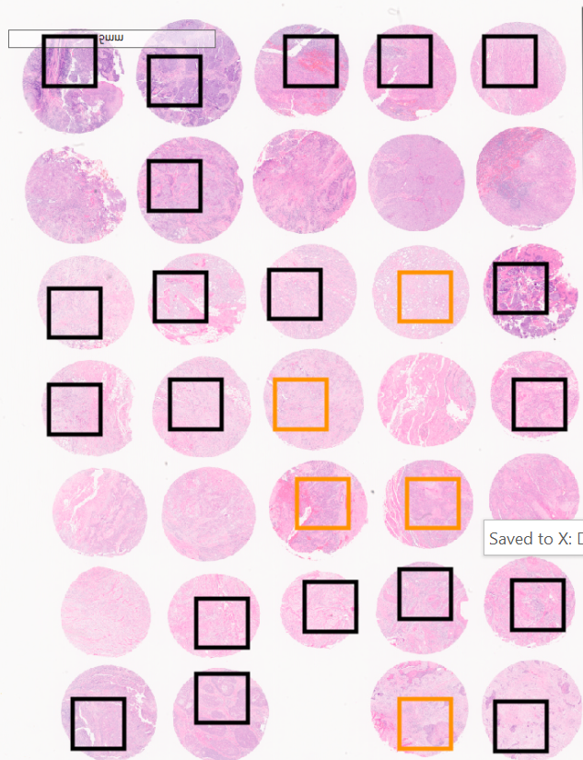
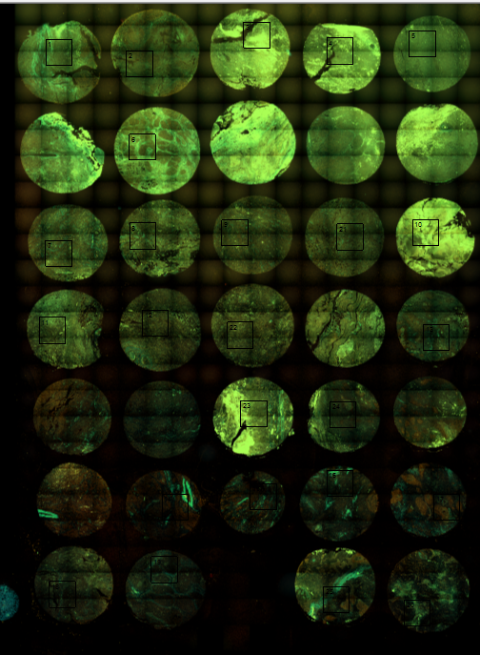
Project Data Summary - RNA
1000-Plex RNA Panel for Cell Typing and Cell-Cell Interaction Studies
CosMx RNA Assay
68 samples from 26 patients of HNSCC
1000 panel protein expression
Applications | # of genes
Cell typing and mapping | 243 genes
Cell state and function | 269 genes
Cell-cell interaction (ligand-receptor) | 435 genes
Hormone activities | 46 genes

Slide 5
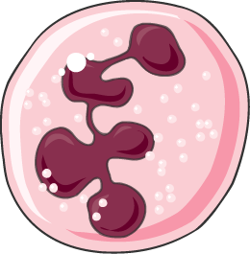
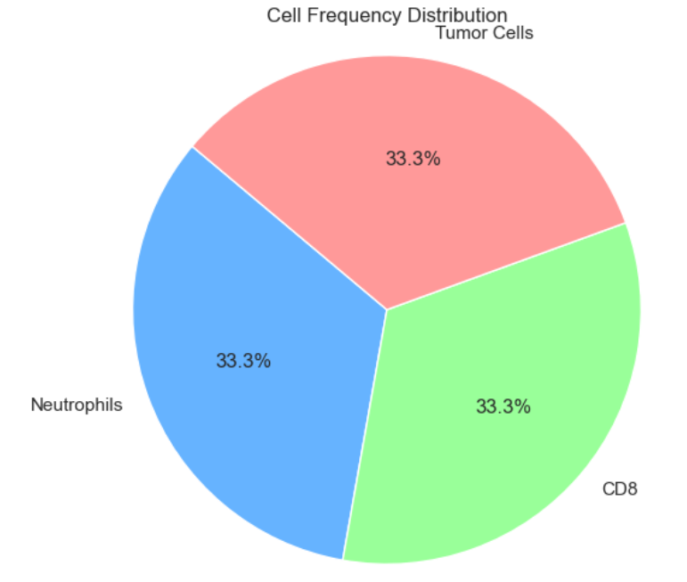
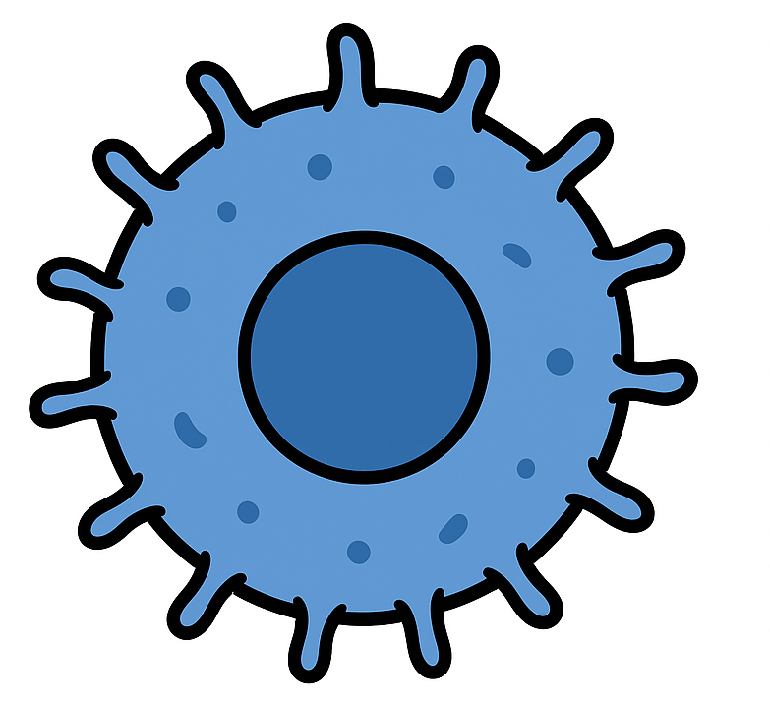

AIM #1 Methodology
Neutrophil Interaction Quantified by Proximity
There is no set standard but 15 µm is a common value used in literature for proximal interaction (1).
PMN
15 µm
CD8+ T-Cell
Tumor Cell
PMN

Slide 6
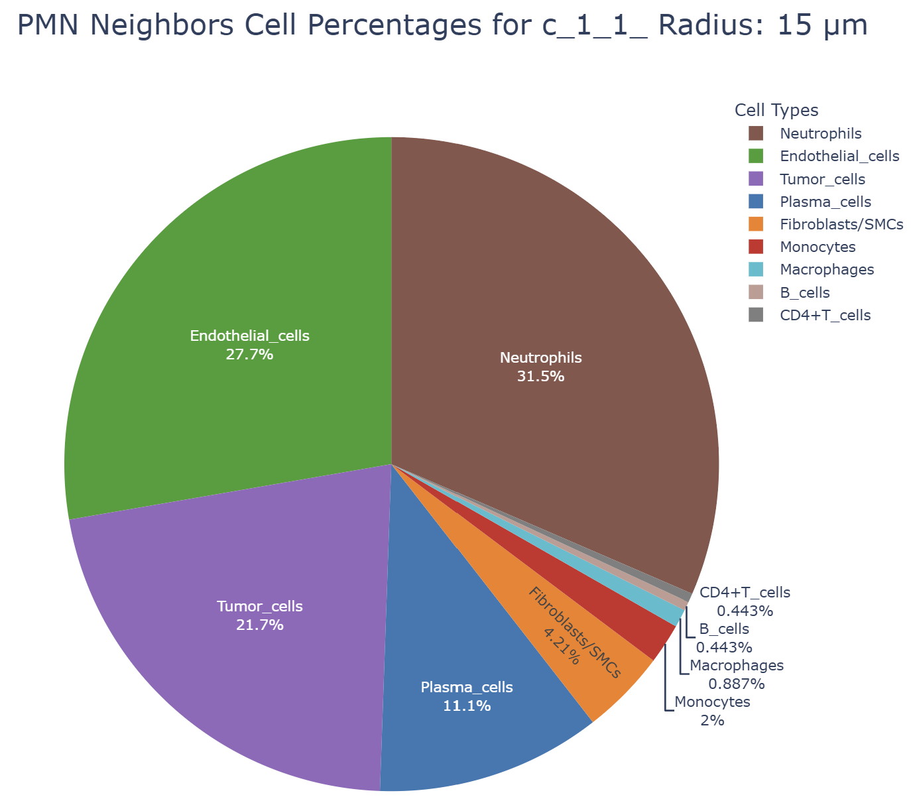
Example Neutrophil Cellular Neighborhood
The cellular neighborhood, defined as the cells in close proximity to neutrophils, was quantified for each sample.
A measure of what type of cells neutrophils interact.

Slide 7
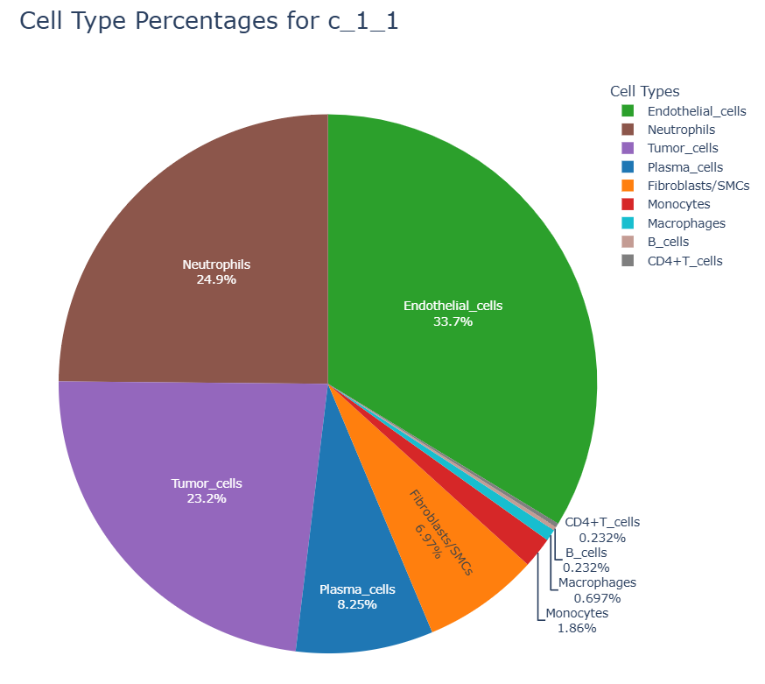
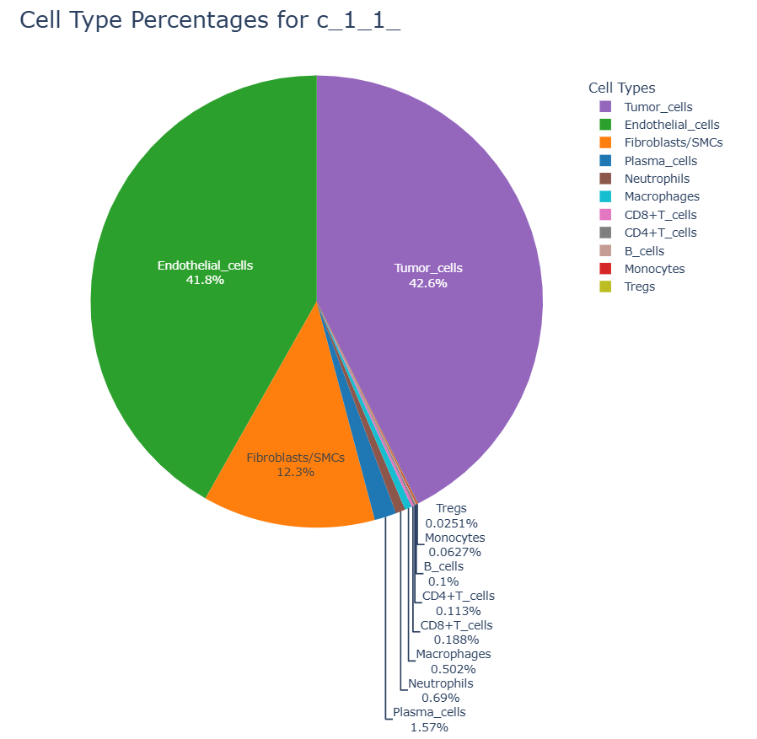
Delta Cell Interaction Percentages
Neighboring Cells
-
Overall Sample Frequency
=
Delta Matrix
PMN = 24.9 – 0.96 =24.16%
Tumor=-19.4%
Endo= - 8.1%
Etc…..

Slide 8
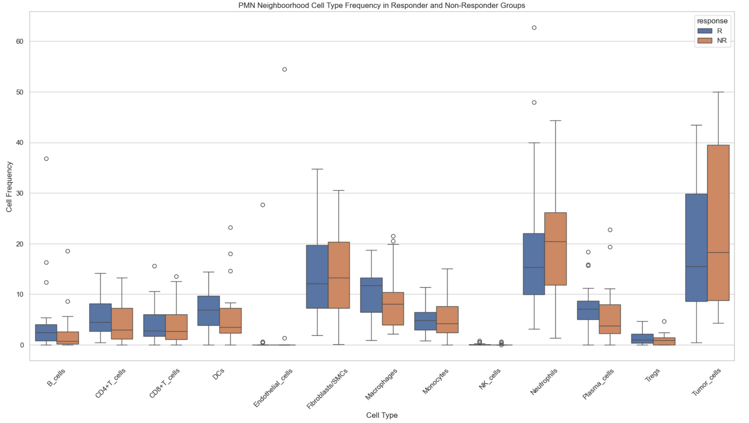
Box Plot of Cellular Neighborhood

Slide 9
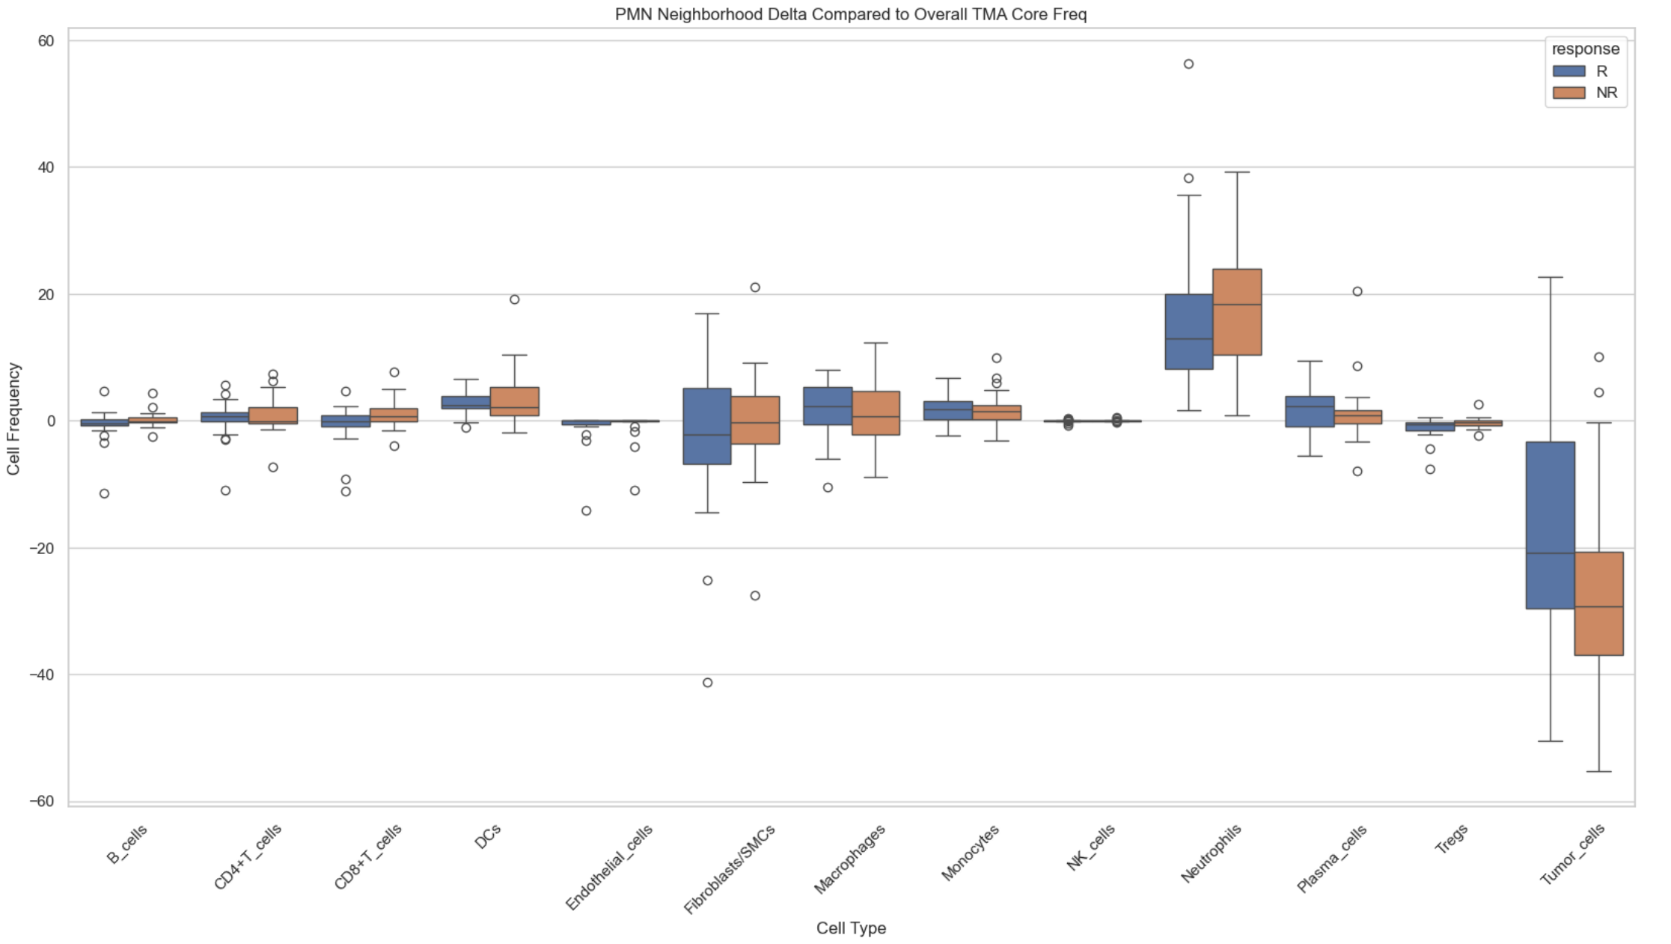
Box Plot of Delta Cellular Neighborhood

Slide 10
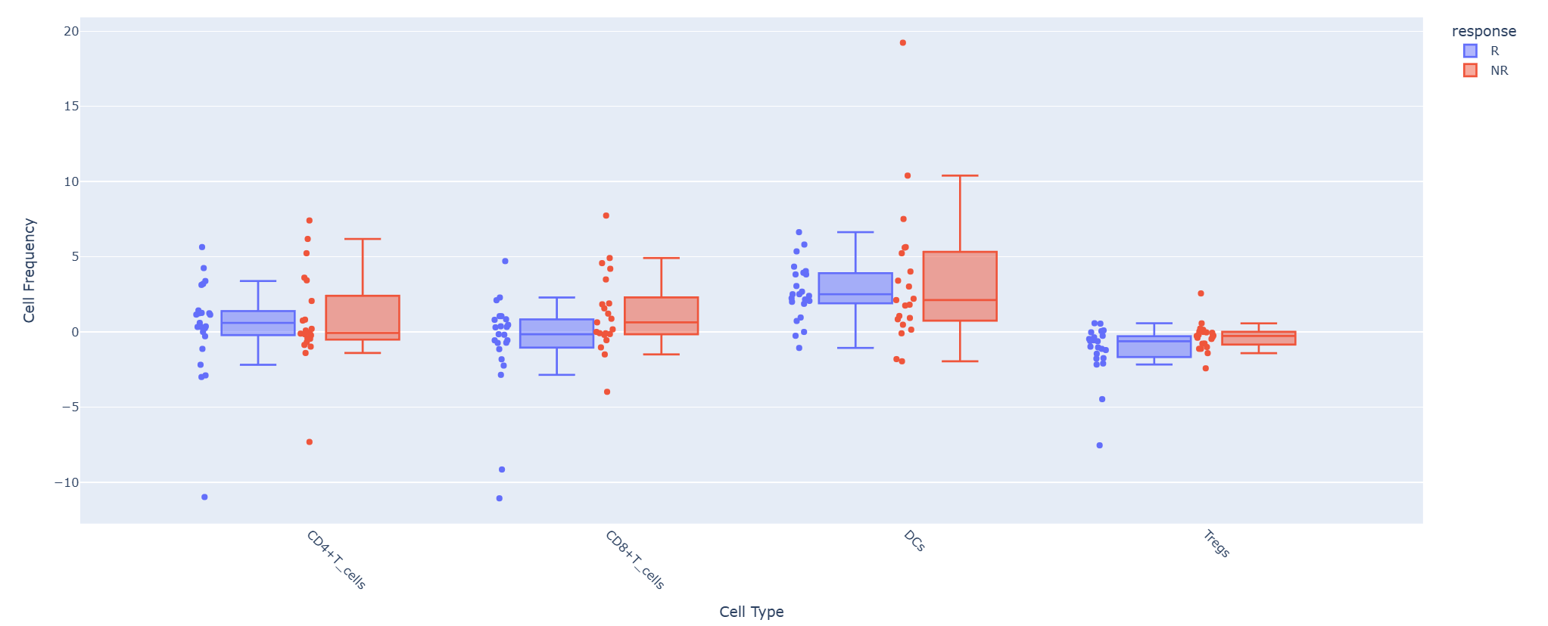
Select Box Plot Neighborhood Delta (Radius = 15 µm)
*
*
Takeaways
Non-Responders have fewer CD8 T-cells than responders but are significantly more likely to interact with neutrophils relative to their frequency. (p=0.036) at 15-micron radius.
Non-Responder neutrophils are also significantly more likely to interact with Treg cells than their frequency
No notable difference of neutrophil interaction with CD4 and DCs between NR and R groups.
Note: DCs and B_cells are more common in responders but don’t interact with pmns more than responders.

Slide 11
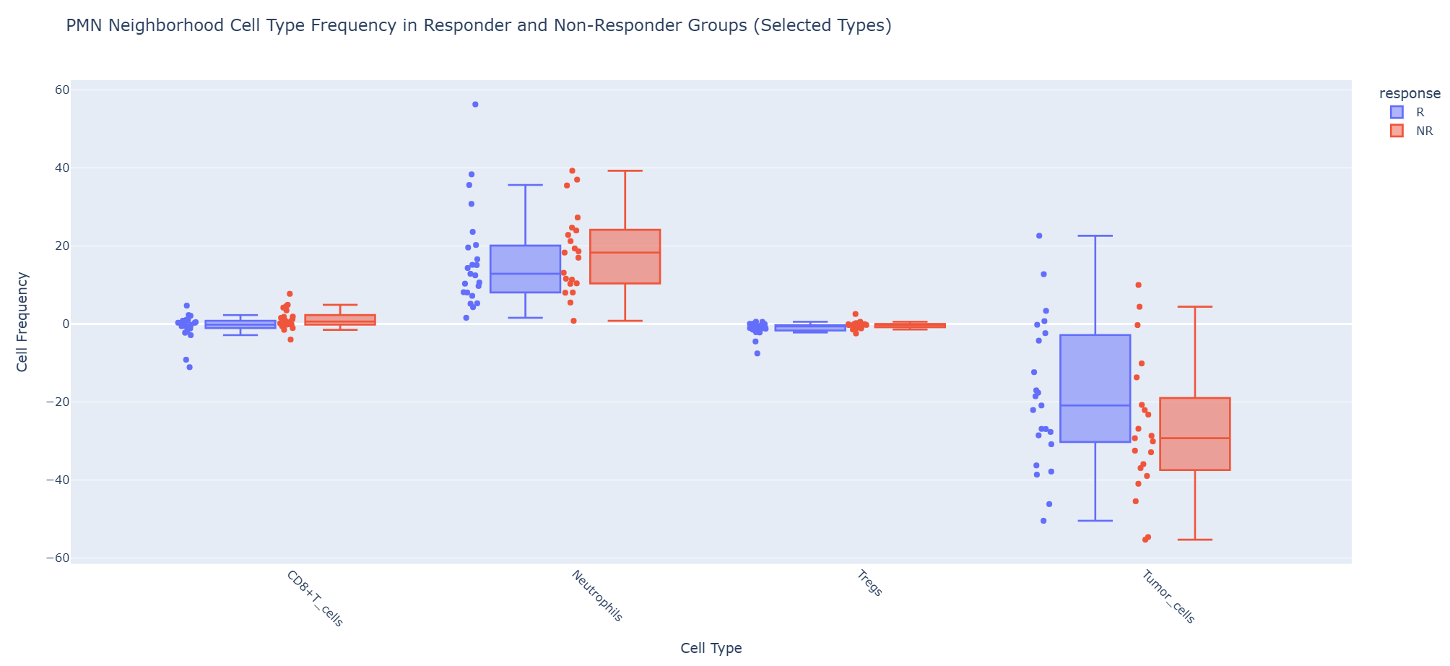
Select Box Plot Neighborhood Delta (Radius = 15 µm)
*
*
Takeaways
Higher variation in neutrophil and tumor cells interactions
Responders have higher neutrophil tumor interactions relative to overall frequency. Data is not significant (p=0.13) at 15-micron radius.
Neutrophils clustering is slightly more common in non-responders, but variation is high (p=0.63) at 15-micron radius.

Slide 12
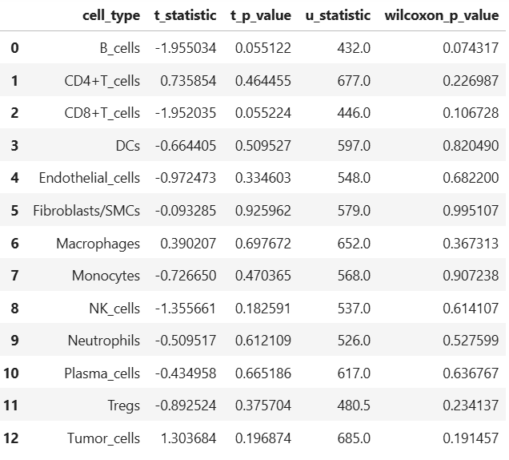
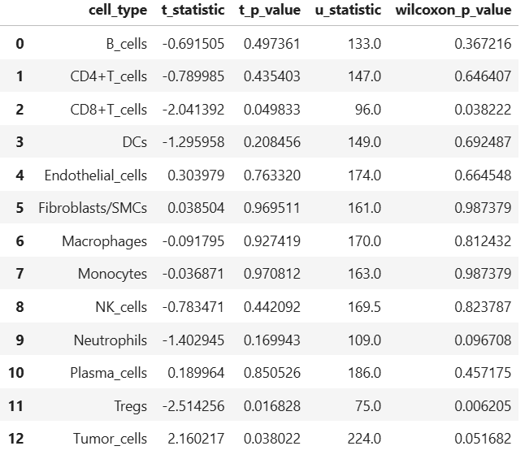
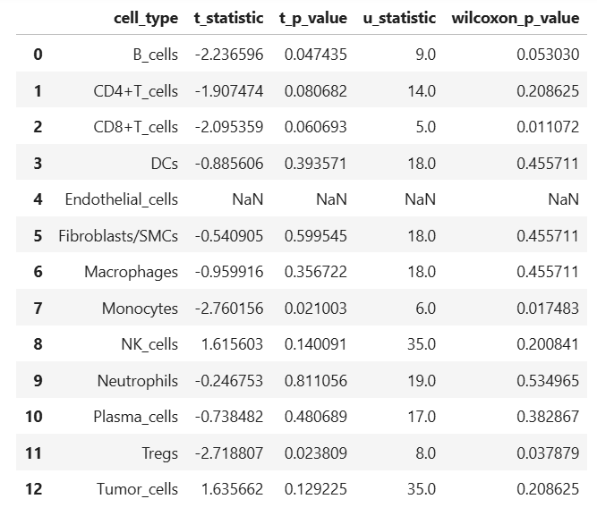
Statistical Significance (wilxoxon)
Delta with overall frequency Matrix R vs NR
PMN>0.1% n=66
PMN>1% n=34
PMN>3% n=12

Slide 13
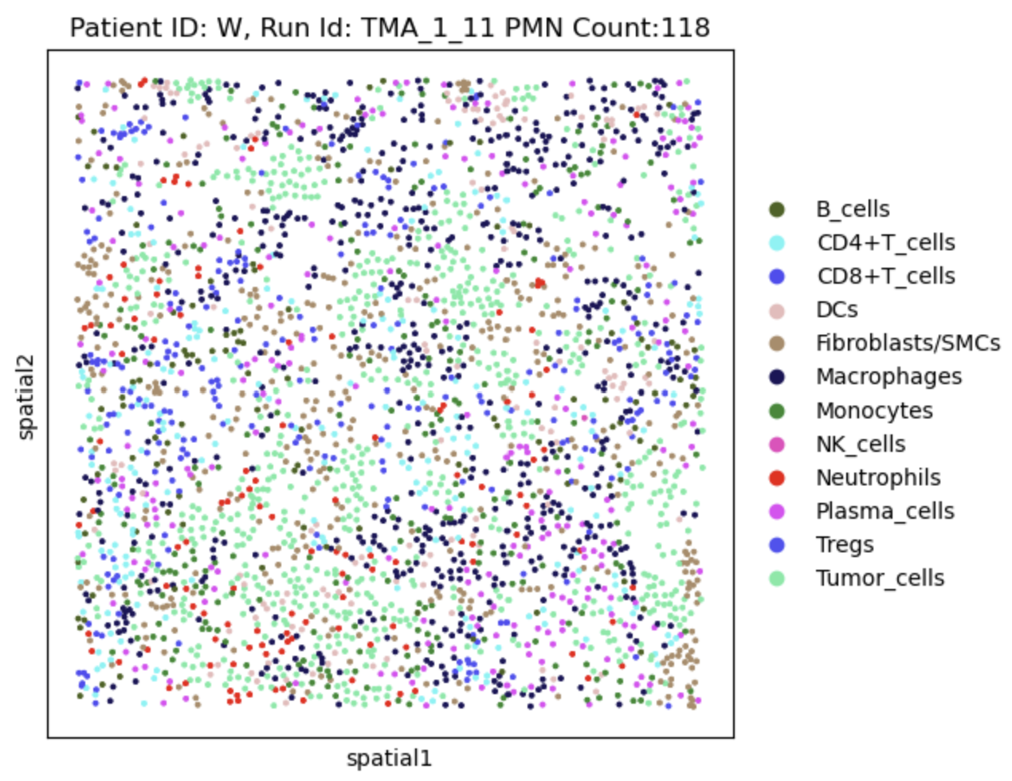
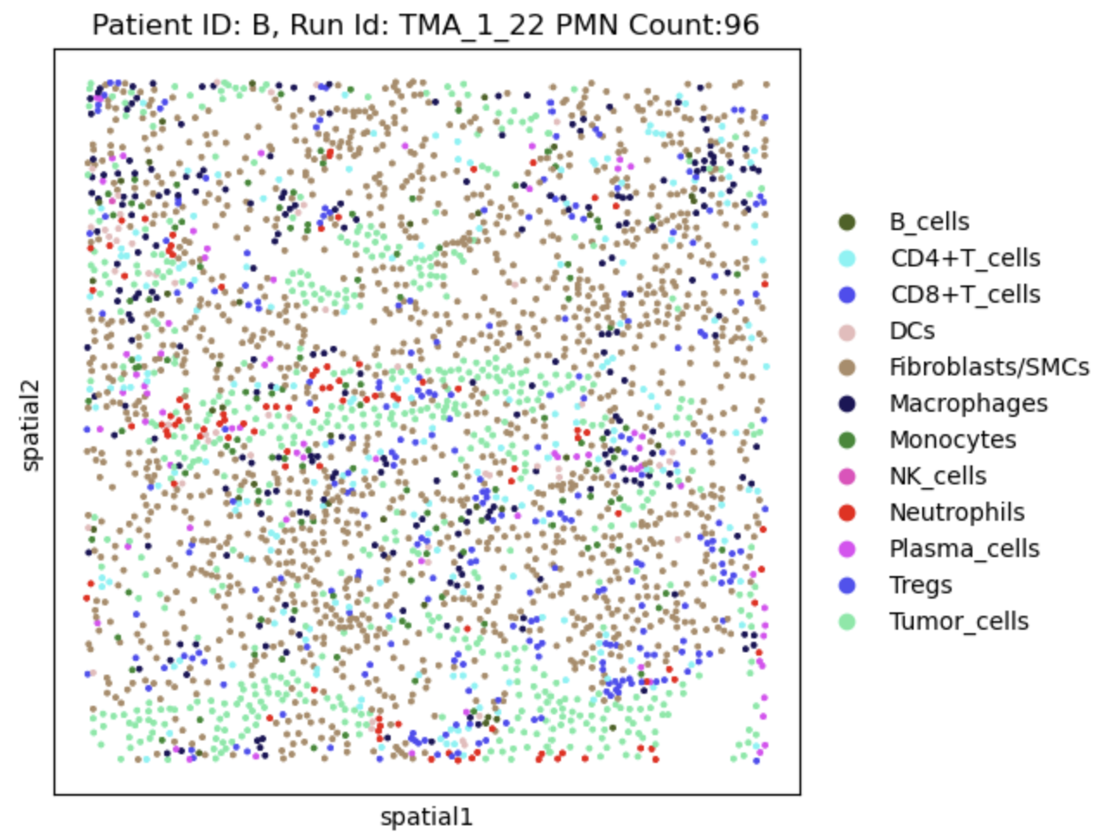
NR vs R example CD8-PMN Colocalization – All Cells
Responder
Non-Responder
Cell Composition:
CD8: 5.63%, PMN: 4.004%, Tumor: 22.1%
Cell Composition:
CD8: 6.14%, PMN: 3.19%, Tumor: 18.8%

Slide 14
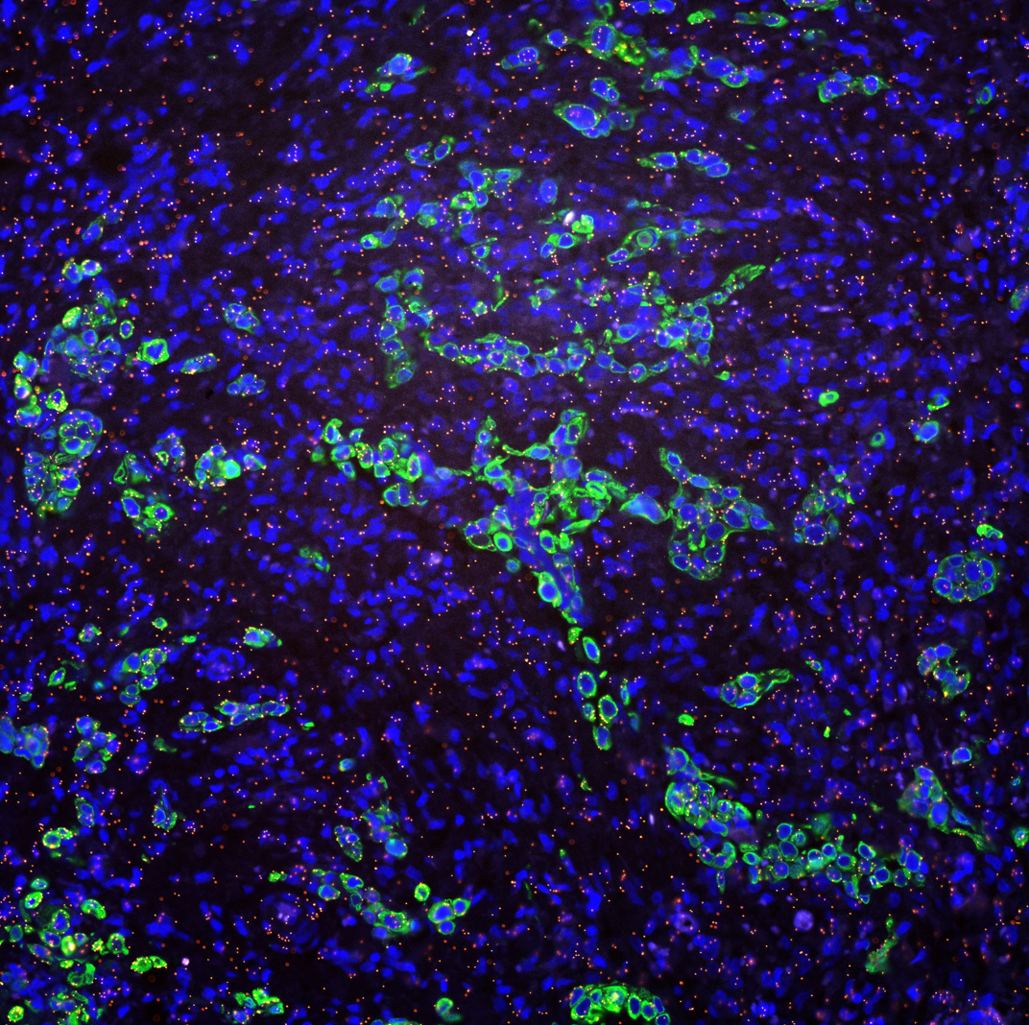
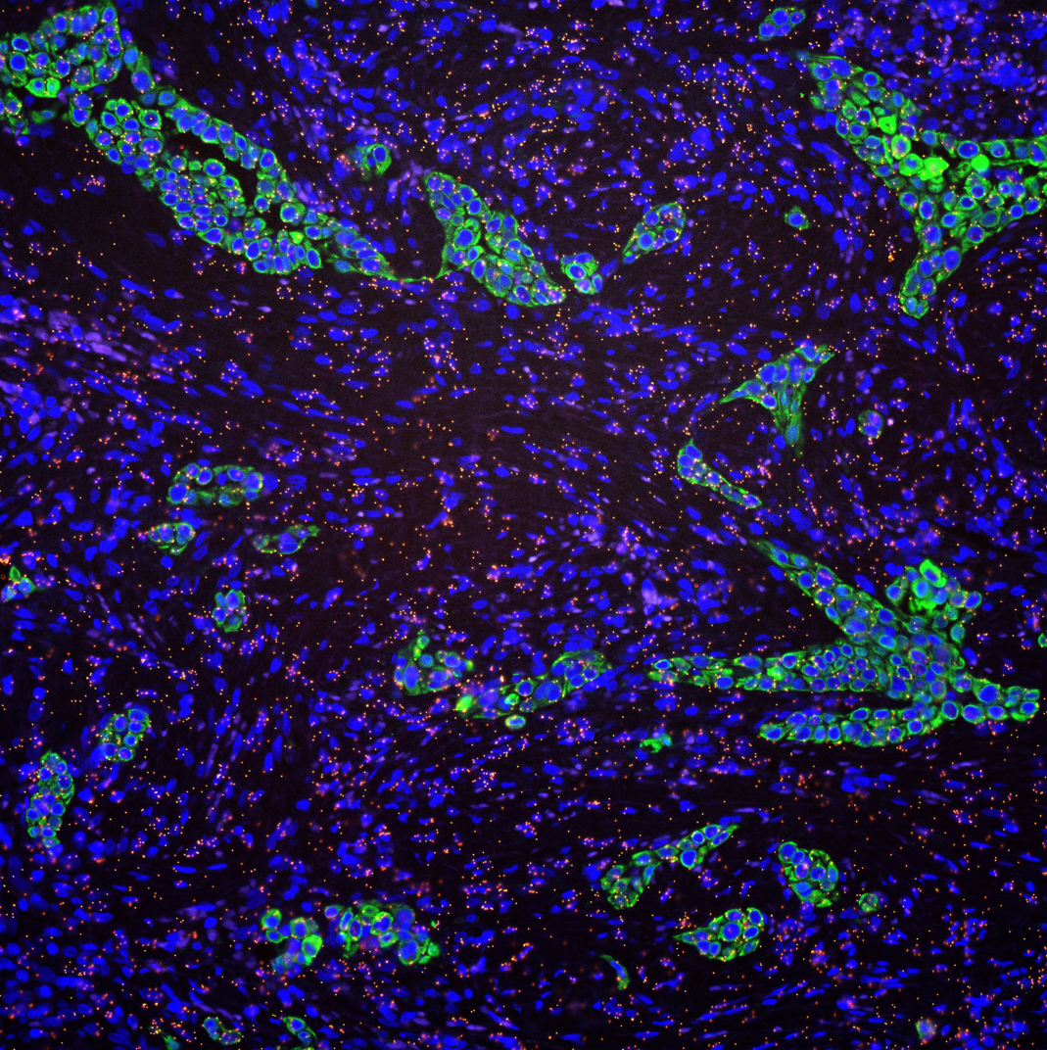
NR vs R example CD8-PMN Colocalization – All Cells
Responder
Non-Responder
Cell Composition:
CD8: 5.63%, PMN: 4.004%, Tumor: 22.1%
Cell Composition:
CD8: 6.14%, PMN: 3.19%, Tumor: 18.8%

Slide 15
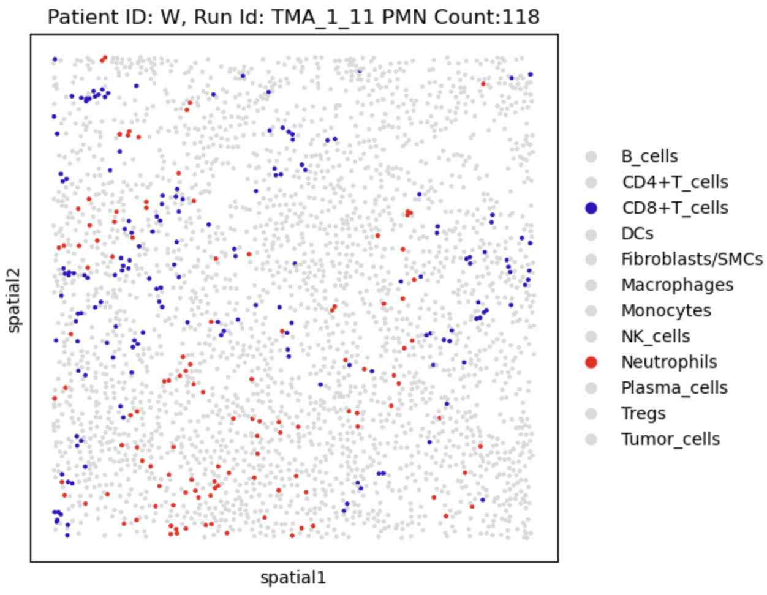
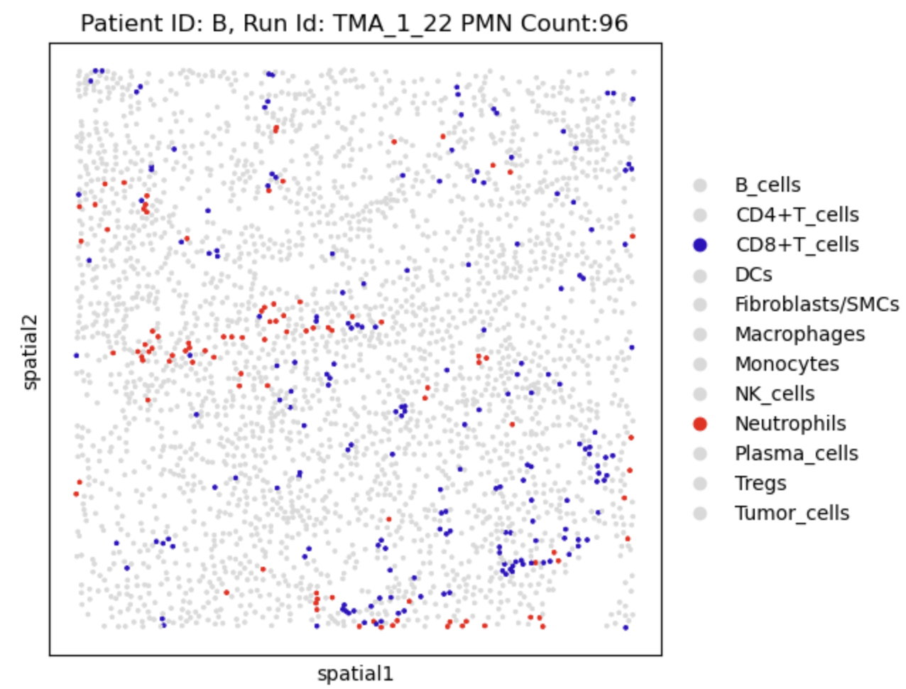
Example of PMN-CD8 interactions between responder and non-responders
Responder
Non-Responder
Colocalization:
15-micron radial PMN-CD8: 2.78%
Delta (%Neighboors - %Overall): -2.86%
Colocalization:
15-micron radial: 7.017%
Delta (%Neighboors - %Overall): 0.87%

Slide 16
Protein Expression Findings
Responders versus non-responders
No significant gene expression differences in CD8, Treg, or Neutrophil cells once accounting for multisampling false positive probability
Cell interaction checks
PMN interacting with CD8 cells
CD8 interacting with PMN
Treg interacting with PMN
No significant changes once accounting for multisampling false positive probability

Slide 17
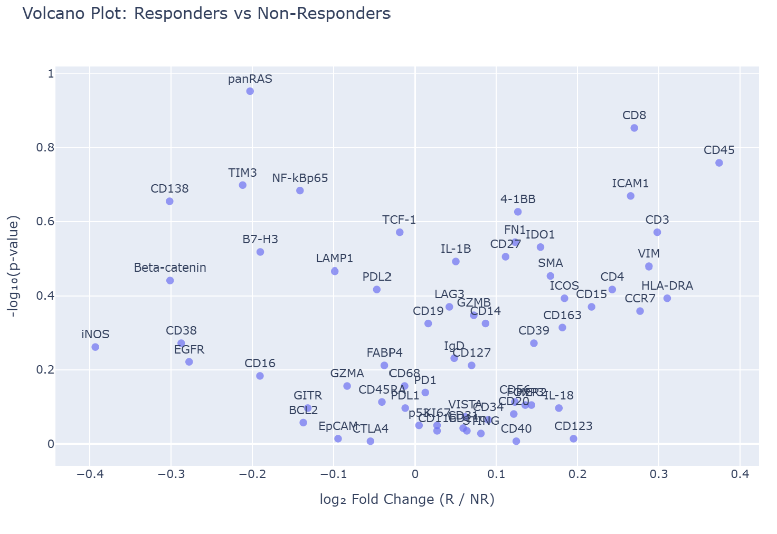
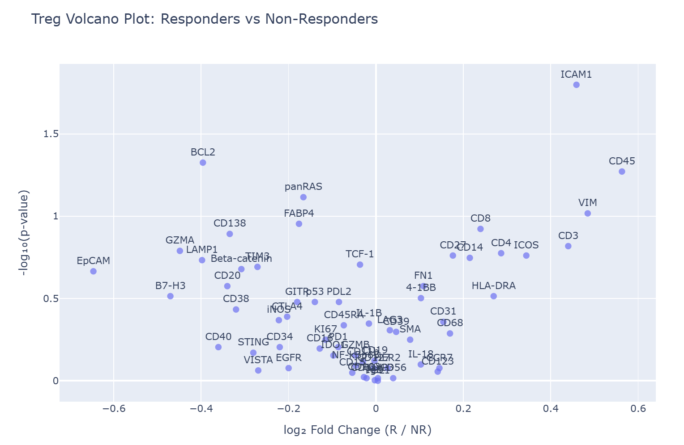
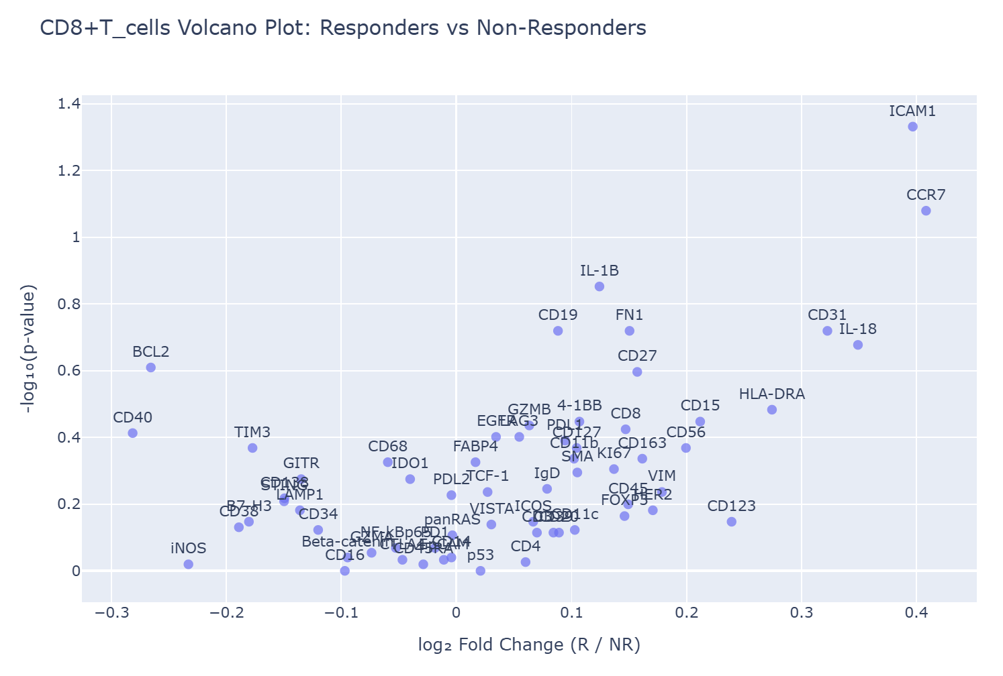
Protein Gene Expression
PMN
Treg
CD8
No significant differences in protein expression after accounting for expected false discovery rate. Logical result as the cosMX 64 protein panel focuses on cell identification not cell-cell interaction

Slide 18
AIM #1 Conclusions
Neutrophils interactions CD8 and Treg cells, relative to overall cellular frequency, is a significantly correlated with non-responder patients. At the same time non-responder patients have fewer overall CD8 and Treg cells suggesting the neutrophils cells may suppress recruitment and proliferation of T-cells.
Neutrophil interactions with tumor cells, relative to overall cellular frequency, has a non-significant correlation with the patient being responsive to treatment. While non-responder patients typically had a higher proportion of tumor cells neutrophils were more likely to interact with tumor cells in responders suggesting that neutrophils may have anti-tumor interactions.
No significant protein expression differences in protein expression between responders and non-responders. Not too surprising as markers are more for identification

Slide 19
AIM 2 Progress and Difficulties
Research AIM 2: Label Neutrophils in the mRNA CosMX samples and identify Ligand-Receptor Pairs Associated with Neutrophil and T cell Interactions
Identification challenges
Neutrophils are short lived cells with high RNase activity and low transcriptional activity causing overall mRNA expression to be low. (2)
The cosMX protein and mRNA samples are often misaligned and come from a different z-plane making mapping protein identifiers difficult.
Potential mRNA markers of neutrophils do not show reliable relation to neutrophil locations

Slide 20
mRNA potential markers for Neutrophils
Possible mRNA markers for PMN cells
CSF3R – Granulocyte Colony-Stimulating Factor Receptor
MPO – Myeloperoxidase
ELANE – Neutrophil elastase
AZU1 – Azurocidin
LCN2 – Lipocalin 2
S100A8 / S100A9 – Calgranulin A and B
FPR1 – Formyl Peptide Receptor 1
CXCR1 / CXCR2 – IL-8 receptors
CAMP – Cathelicidin Antimicrobial Peptide

Slide 21
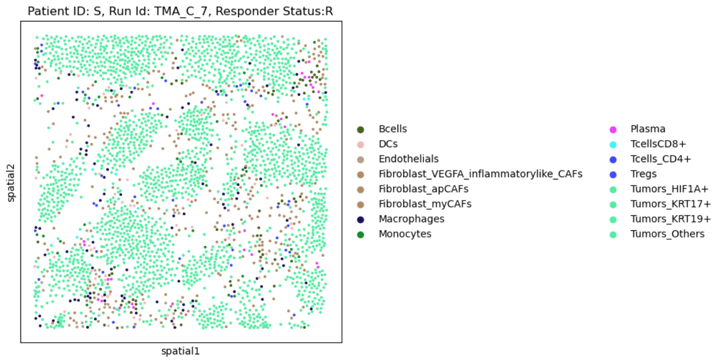
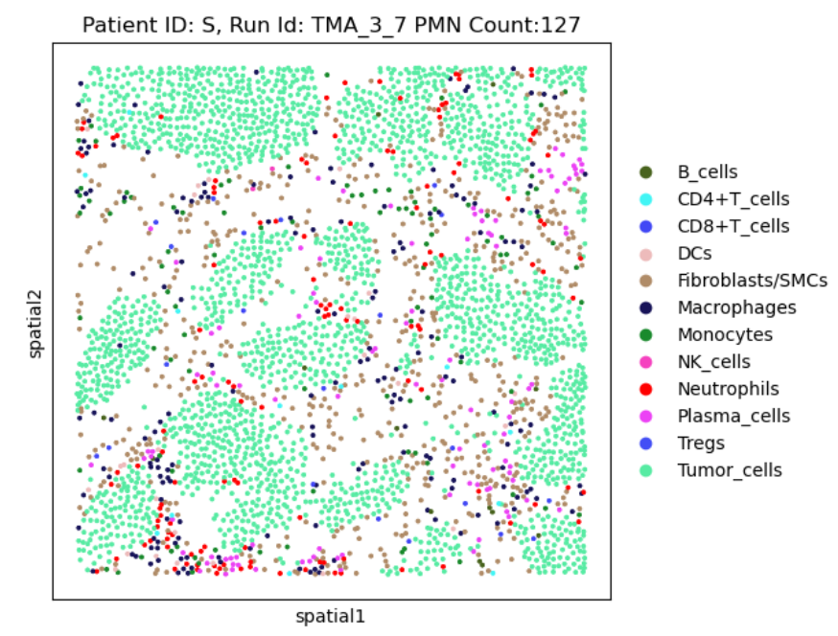
Mapping Protein to mRNA
mRNA
Protein
Suspected Neutrophils

Slide 22
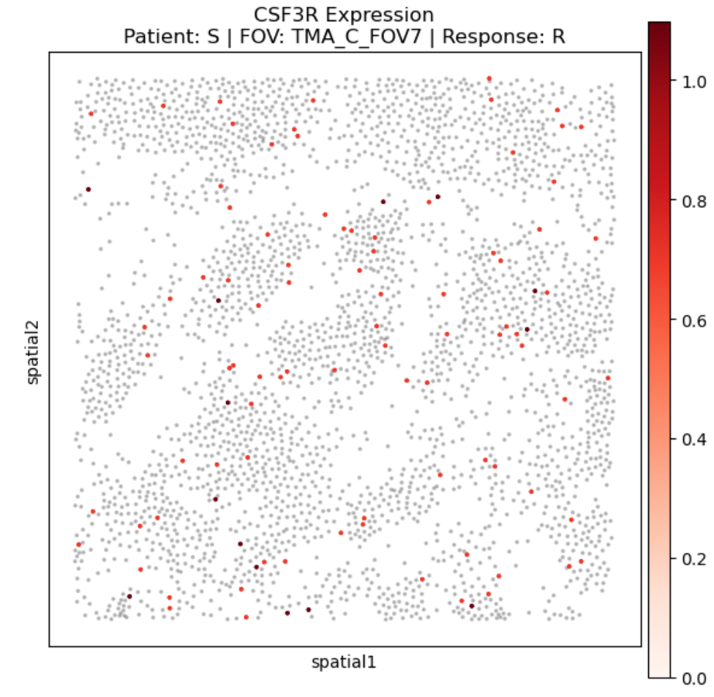
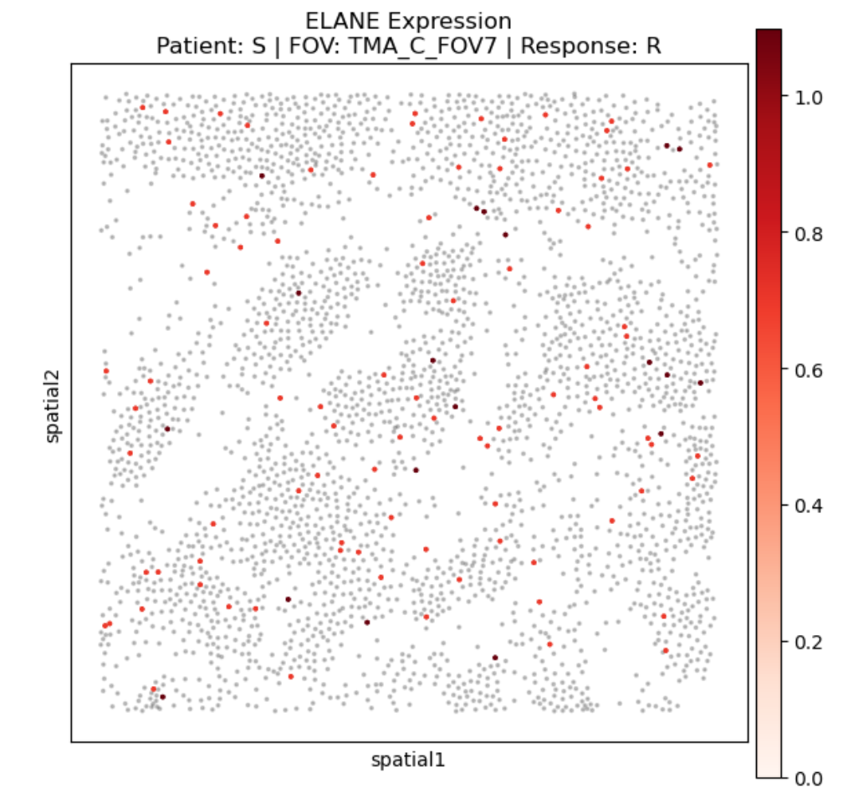
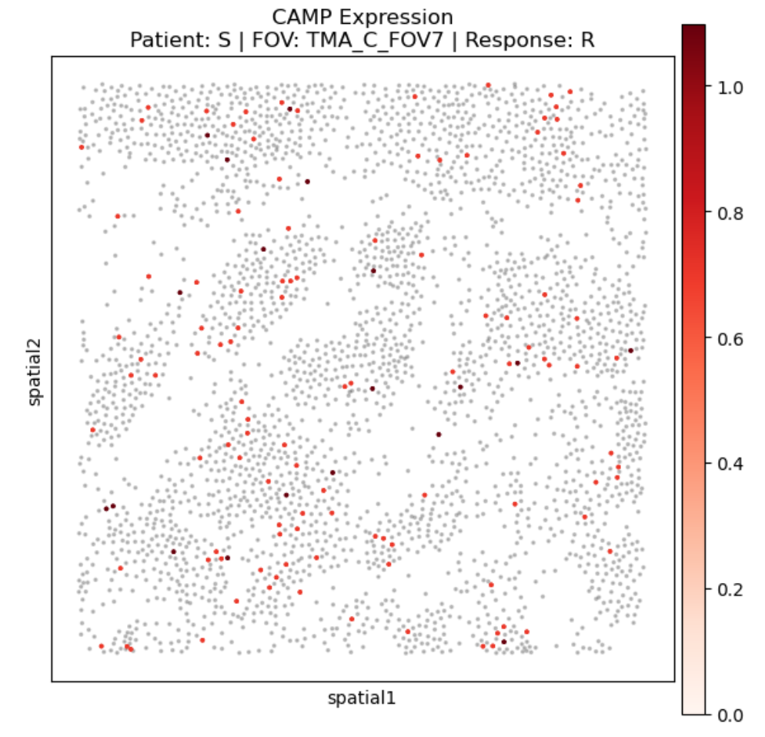
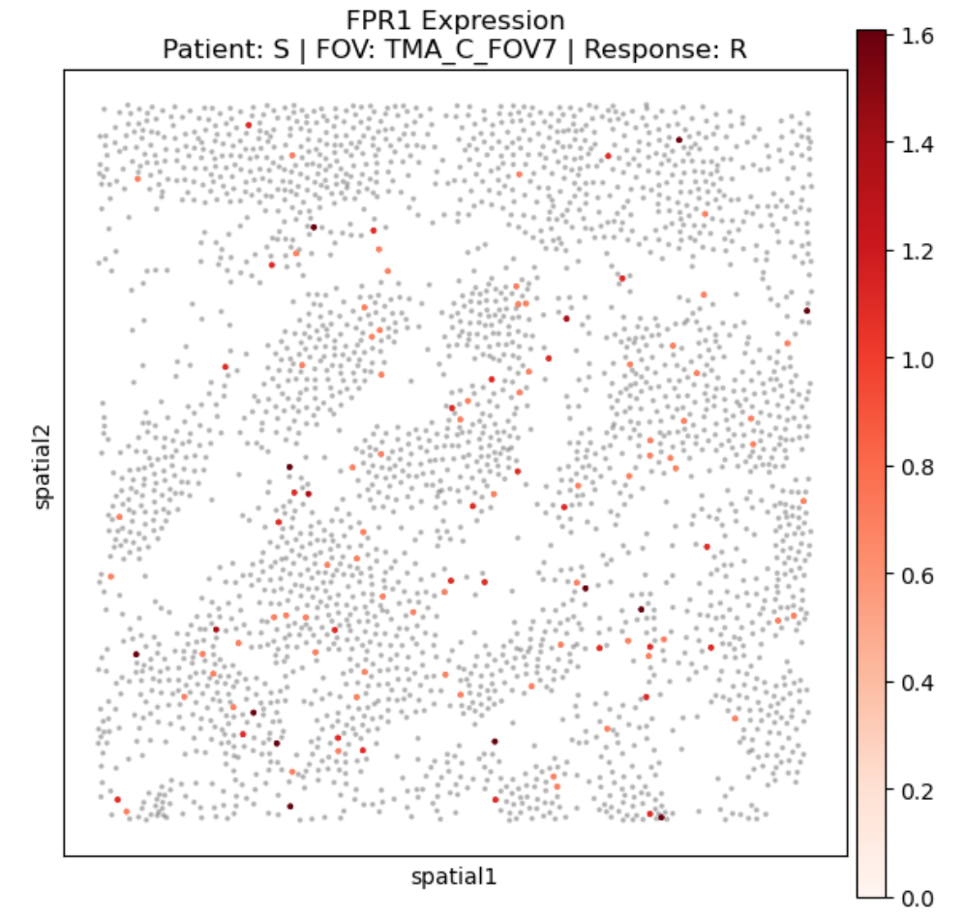
Mapping Protein mRNA
mRNA

Slide 23
Current and Future Protects
Lieden clustering of the protein data, for verification on methodology, followed by clustering of mRNA cosMX samples. May be possible to identify neutrophils using this methodology.
For example, the low mRNA expression of neutrophils may be a maker.
Comparing mRNA expression between samples groups
Responders versus non-responders
High Neutrophil-CD8 colocalization versus low colocalization
High Neutrophil-Treg colocalization versus low colocalization

Slide 24
References
Oh J, Hoelzl J, Carlson JCT, Bill R, Peterson HM, Faquin WC, Pittet MJ, Pai SI, Weissleder R. Spatial analysis identifies DC niches as predictors of pembrolizumab therapy in head and neck squamous cell cancer. Cell Rep Med. 2025;6(5):102100. doi:10.1016/j.xcrm.2025.102100 PMID:40311615 PMCID:PMC12147904
Ericson JA, Duffau P, Yasuda K, Ortiz‑Lopez A, Rothamel K, Rifkin IR, Monach PA; ImmGen Consortium. Gene expression during the generation and activation of mouse neutrophils: implication of novel functional and regulatory pathways. PLoS One. 2014 Oct 3;9(10):e108553. doi:10.1371/journal.pone.0108553

